Slide 1
Computer Networks
“PHYSICAL LAYER - 2”
Asst. Lect. Ahmed M. Jasim
Computer Department - College of Engineering
University of Diyala
2017

Slide 2
MULTIPLEXING
Multiplexing is a technique by which different analog and digital streams of transmission can be simultaneously processed over a shared link.
Multiplexing divides the high capacity medium into low capacity logical medium which is then shared by different streams.
All mediums are capable of multiplexing.

Slide 3
MULTIPLEXING
When multiple senders try to send over a single medium, a device called Multiplexer divides the physical channel and allocates one to each.
A De-multiplexer receives data from a single medium, identifies each, and sends to different receivers.

Slide 4
MULTIPLEXING
1- Frequency Division Multiplexing
When the carrier is frequency, FDM is used.
FDM is an analog technology.
FDM divides the spectrum or carrier bandwidth in logical channels and allocates one user to each channel.
Each user can use the channel frequency independently and has exclusive access of it.

Slide 5
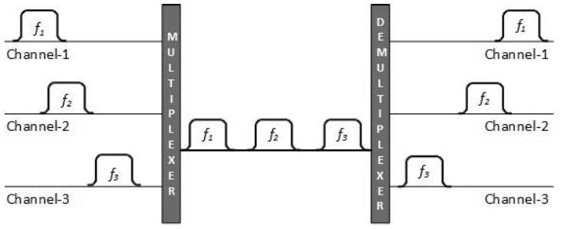
MULTIPLEXING
Channels are separated by guard bands.

Slide 6
MULTIPLEXING
2- Time Division Multiplexing
TDM is applied primarily on digital signals but can be applied on analog signals as well.
In TDM the shared channel is divided among its user by means of time slot.
Each user can transmit data within the provided time slot only.
Digital signals are divided in frames, equivalent to time slot.

Slide 7
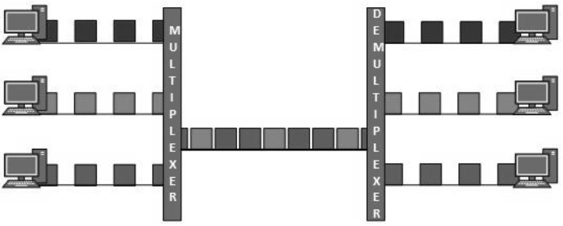
MULTIPLEXING
TDM works in synchronized mode.

Slide 8
MULTIPLEXING
3- Wavelength Division Multiplexing
Light has different wavelength (colors).
In fiber optic mode, multiple optical carrier signals are multiplexed into an optical fiber by using different wavelengths.
This is an analog multiplexing technique and is done conceptually in the same manner as FDM but uses light as signals.

Slide 9
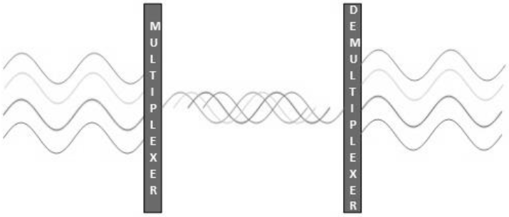
MULTIPLEXING
Further, on each wavelength time division multiplexing can be incorporated to accommodate more data signals.

Slide 10
MULTIPLEXING
4- Code Division Multiplexing
FDM divides the frequency in smaller channels but CDM allows its users to full bandwidth and transmit signals all the time using a unique code.
CDM uses orthogonal codes to spread signals.
Each station is assigned with a unique code, called chip.
The receiver knows in advance the chip code signal it has to receive.

Slide 11
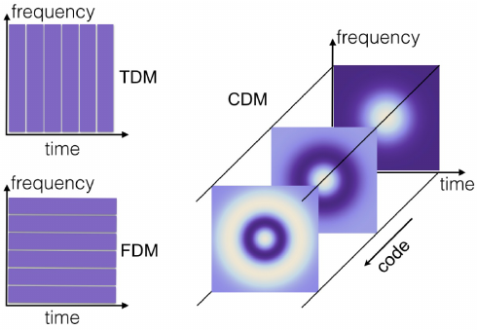
MULTIPLEXING

Slide 12
SWITCHING
Switching is process to forward packets coming in from one port to a port leading towards the destination.
When data comes on a port it is called ingress.
when data leaves a port or goes out it is called egress.
Switching can be divided into two major categories:
Connectionless
Connection Oriented

Slide 13
SWITCHING
1- Circuit Switching
When two nodes communicate with each other over a dedicated communication path, it is called circuit switching.
There is a need of pre-specified route from which data travels and no other data is permitted.
In circuit switching to transfer the data, circuit must be established so that the data transfer can take place

Slide 14
SWITCHING
Circuits can be permanent or temporary.
Applications which use circuit switching may have to go through three phases:
Establish a circuit
Transfer the data
Disconnect the circuit
Circuit switching was designed for voice applications.

Slide 15
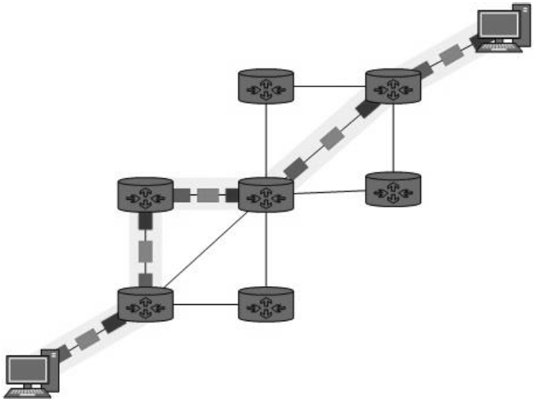
SWITCHING

Slide 16
SWITCHING
2- Message Switching
In message switching, the whole message is treated as a data unit and is switching/transferred in its entirety.
First switch receives the whole message and buffers it until there are resources available to transfer it to the next hop.
If the next hop is not having enough resource to accommodate large size message, the message is stored and switch waits.

Slide 17
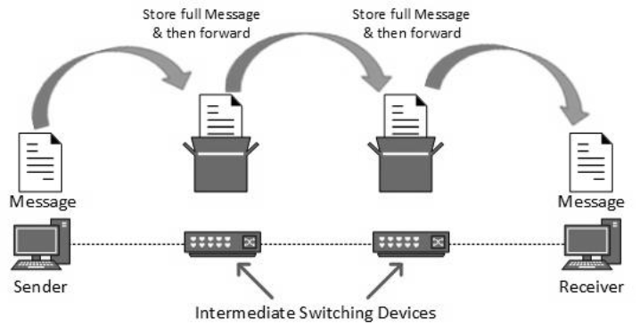
SWITCHING

Slide 18
SWITCHING
Message switching has the following drawbacks:
Every switch in transit path needs enough storage to accommodate entire message.
Because of store-and-forward technique and waits included until resources are available, message switching is very slow.
Message switching was not a solution for streaming media ((audio, video) and real-time applications.

Slide 19
SWITCHING
3- Packet Switching
The entire message is broken down into smaller chunks called packets.
The switching information is added in the header of each packet and transmitted independently.
It is easier for intermediate networking devices to store small size packets.

Slide 20
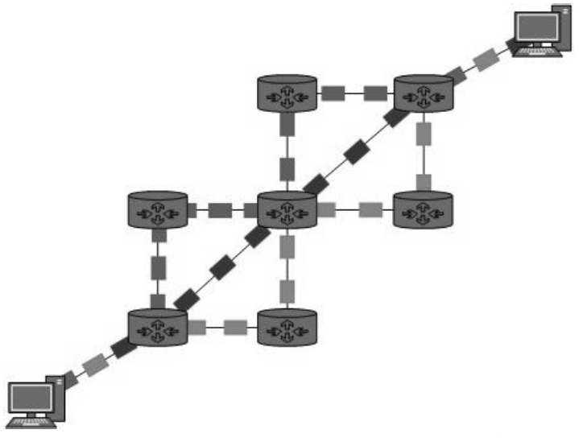
SWITCHING
Packet switching enhances line efficiency.
Packet switching enables the user to differentiate data streams based on priorities.

Slide 21
THANK YOU

